Slide 1
Math's practical
Solution of system of ordinary differential equation

Slide 2
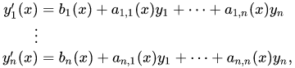
What is a system of linear differential equation?
A
system of linear differential equations consists of several linear differential equations that involve several unknown functions.
An arbitrary linear ordinary differential equation and a system of such equations can be converted into a first order system of linear differential equations by adding variables for all but the highest order derivatives.
A linear system of the first order, which has n unknown functions and n differential equations may normally be solved for the derivatives of the unknown functions.

Slide 3
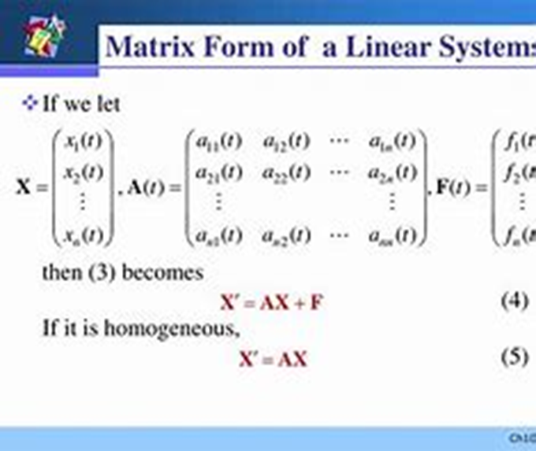
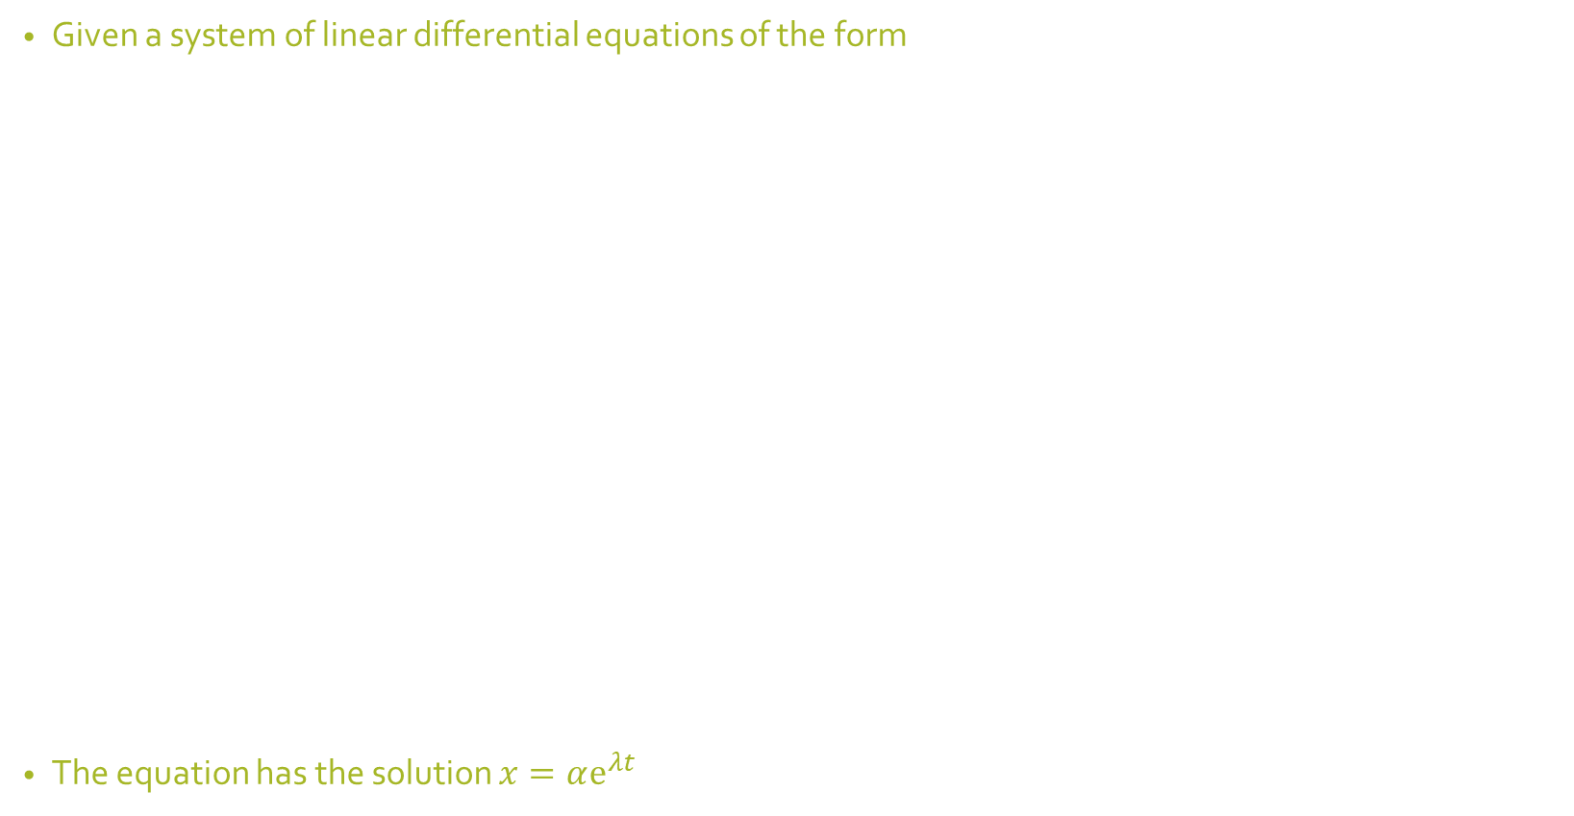
Writing the equation in matrix form-
Given a system of linear differential equations of the form
The equation has the solution $x=αⅇ^{λt}$

Slide 4
Cases of characteristic values
Case 1: 2 distinct and real values
Case 2: distinct and repeated values
Case 3: complex conjugate values

Slide 5
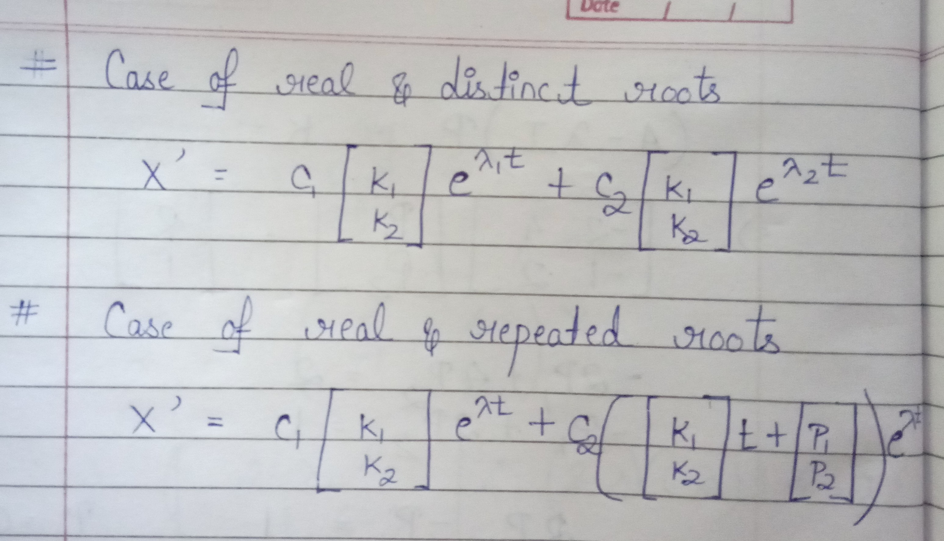

Slide 6
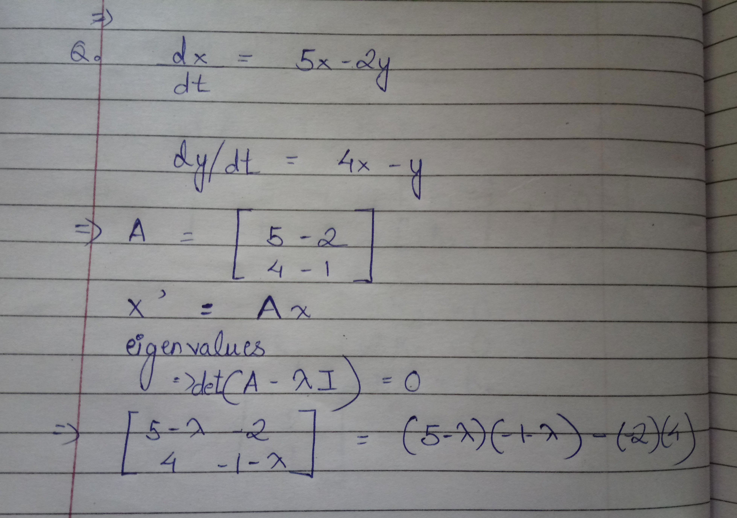

Slide 7
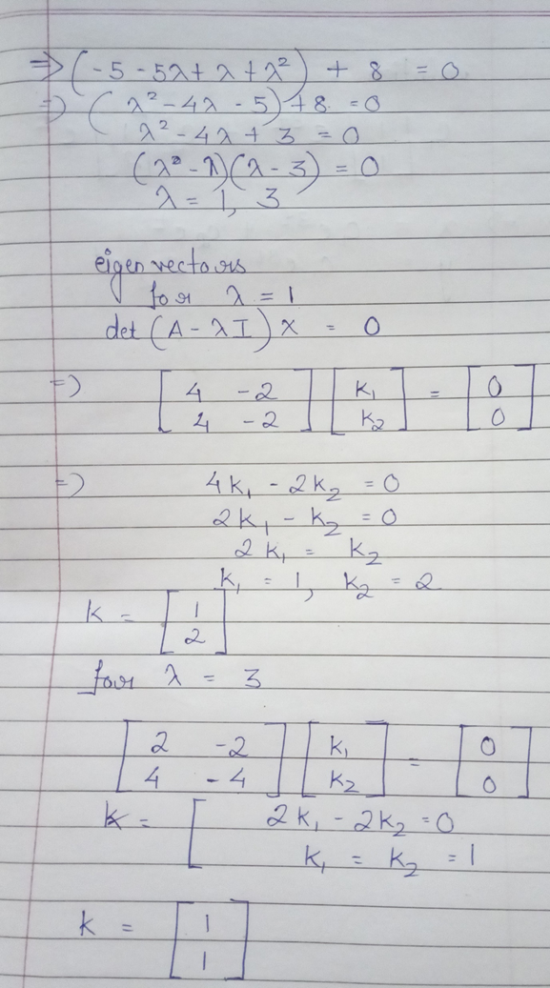
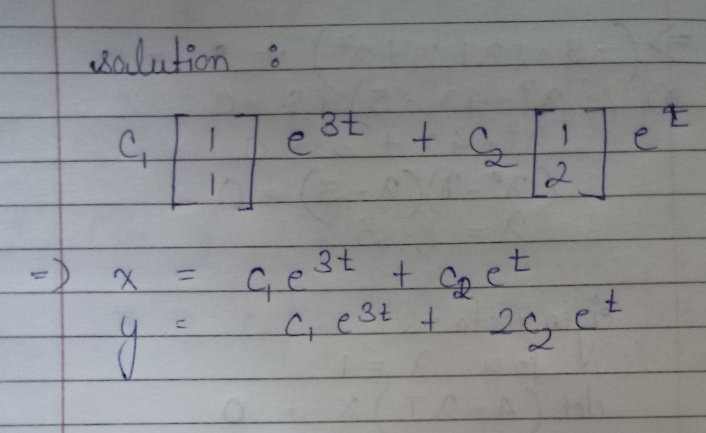

Slide 8
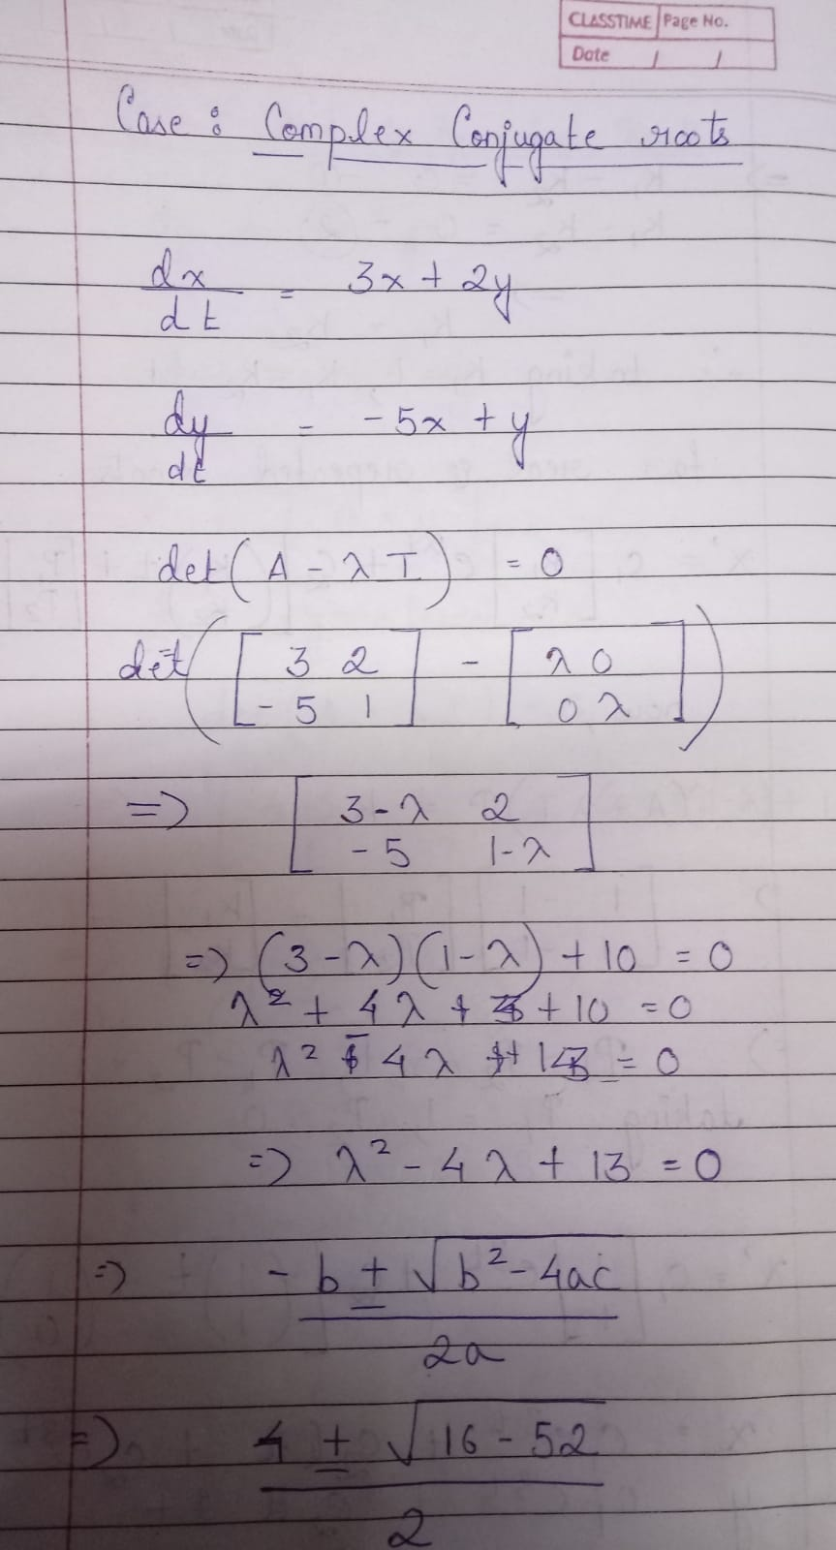
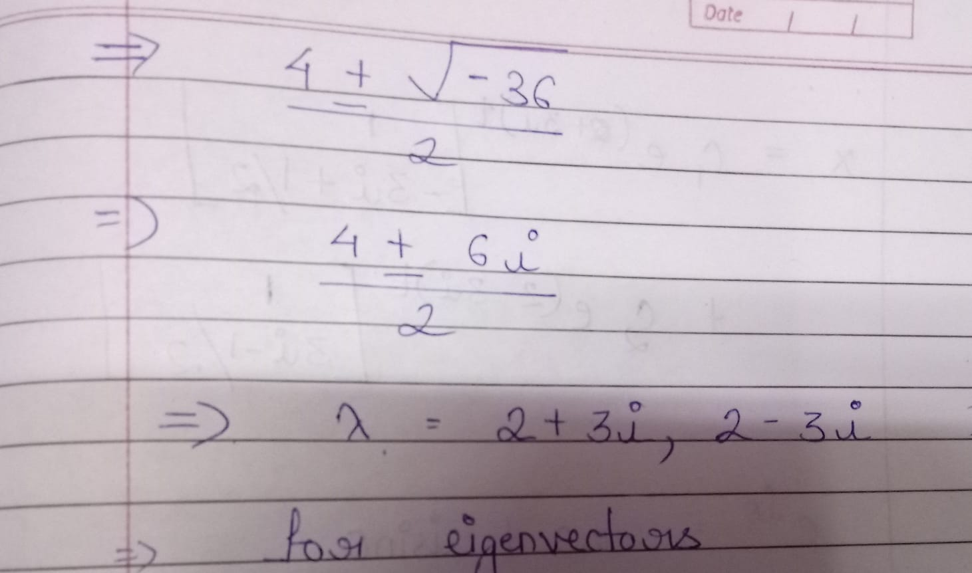

Slide 9
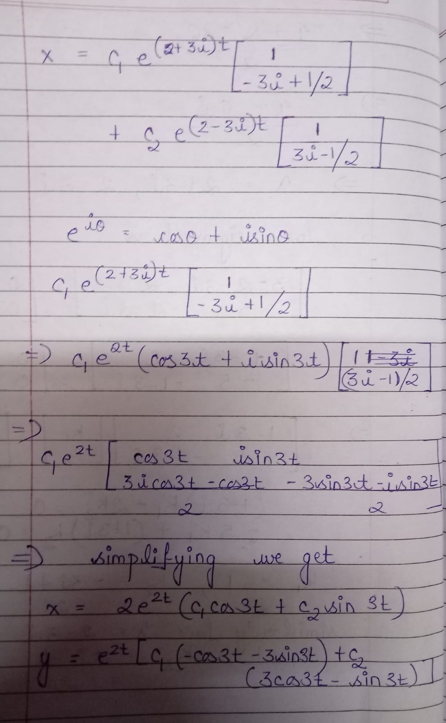
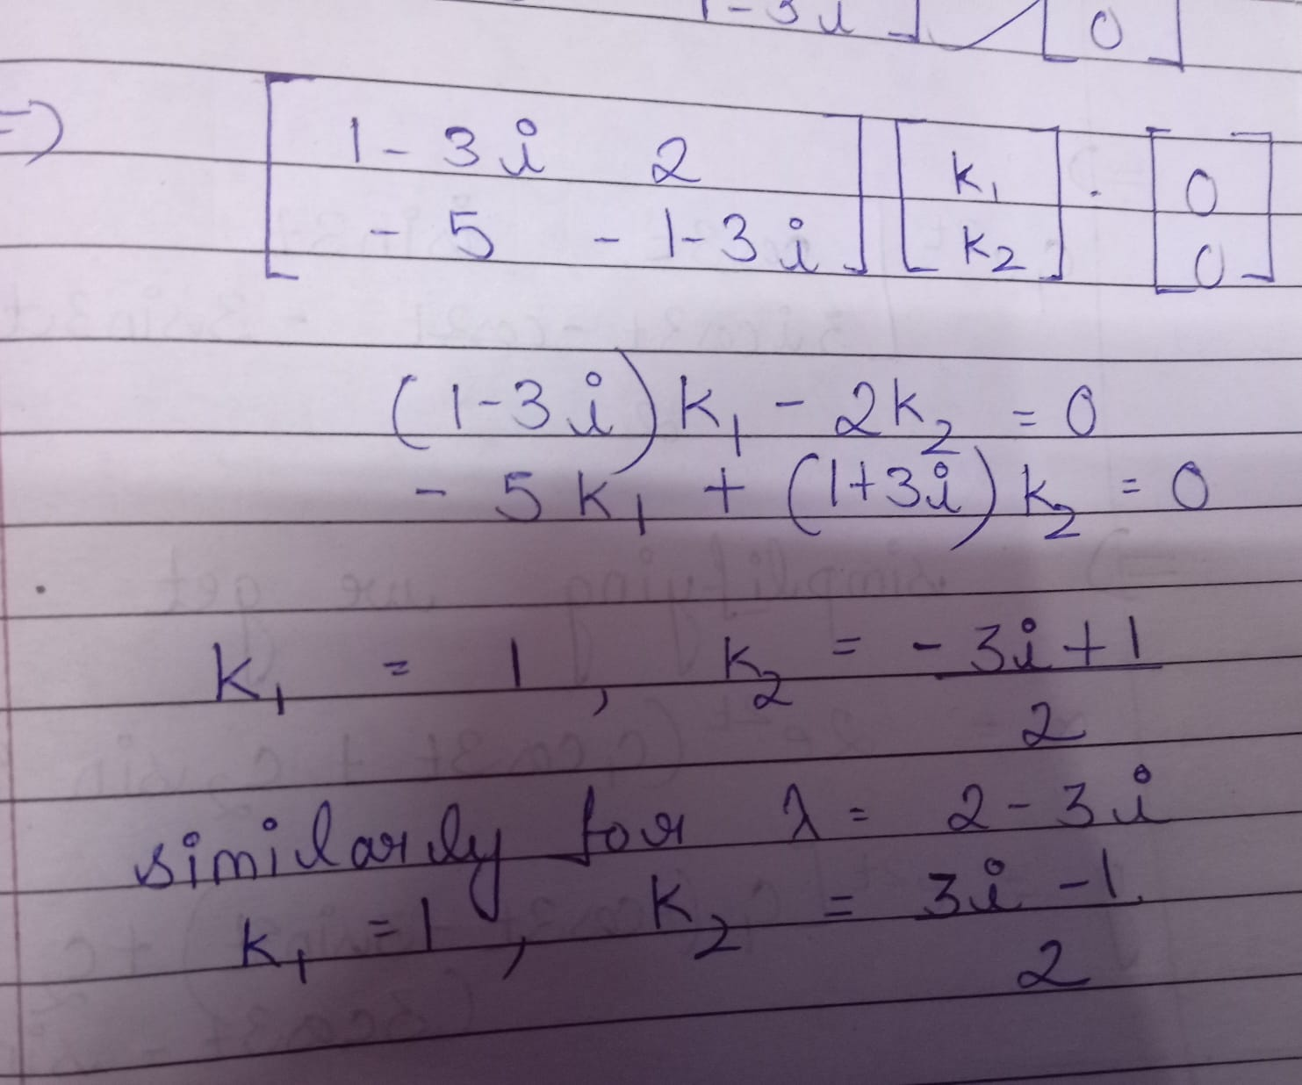

Slide 10
Applications of system of linear differential equation
It is applied in electric circuits to determine resistance and voltage on basis of Kirchhoff's current law
It is used in mechanics to determine the displacement in coupled spring mass systems
It is used in mixture problems to obtain and exactly calculate the amount of substances mixed e.g. brine solutions

